Slide 1

Forensic Analytics
Home
About
Content
Others
Multi-Modal Fraud Detection :
Voter Authenticity & Election Forensics
Faculty :-
Dr. Palani Thanaraj K
Team Members :-
22MIA1013 - Lashitha M
22MIA1024 - Chandra Kiran M
22MIA1049 - Naveen N

Slide 2
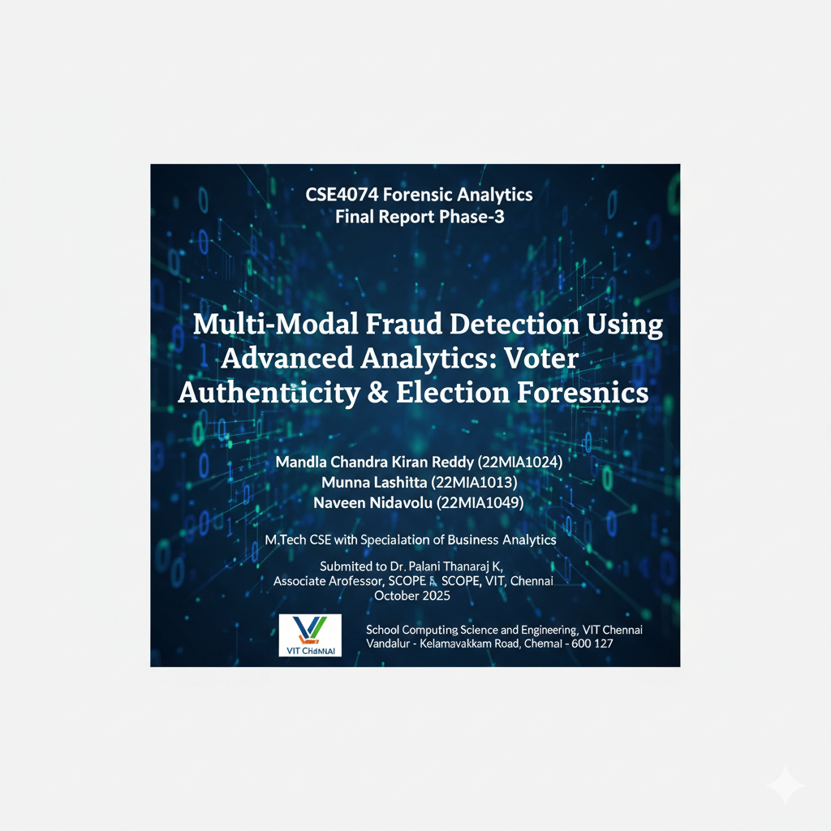
Forensics Analytics
Home
About
Content
Others
Abstract/Executive Summary
Introduction
Methodology
Visualizations
Results & Keyfindings
Conclusions
Table of contents
2

Slide 3

Forensics Analytics
Home
About
Content
Others
Abstract
This project presents a comprehensive, multi-modal forensic analytics framework designed to detect and interpret irregularities in electoral processes by analyzing both structured voter registry data and unstructured social media discourse. Using a synthetic voter dataset of 1,000 records and a corpus of 3,000 election-related tweets, we applied a combination of statistical forensics (including Benford’s Law and outlier analysis), unsupervised anomaly detection (Isolation Forest, DBSCAN), and supervised machine learning (Random Forest classifier). Simultaneously, we utilized natural language processing to examine sentiment, dominant narratives, misinformation trends, and coordinated campaigns within social media.

Slide 4

Forensic Analytics
Home
About
Content
Others
Introduction
Background: Election integrity is vital for democracy but threatened by modern fraud (duplicate identities, fabricated votes, disinformation).
Purpose: Build a pipeline that integrates traditional (registry) forensics with digital (tweet/NLP) analytics for a holistic fraud risk assessment.
Scope:
Voter registry forensics (anomalies, IDs, demographics)
Social media forensics (tweets, rumors, bot activity)
Combined risk scoring and multi-modal dashboards
4

Slide 5
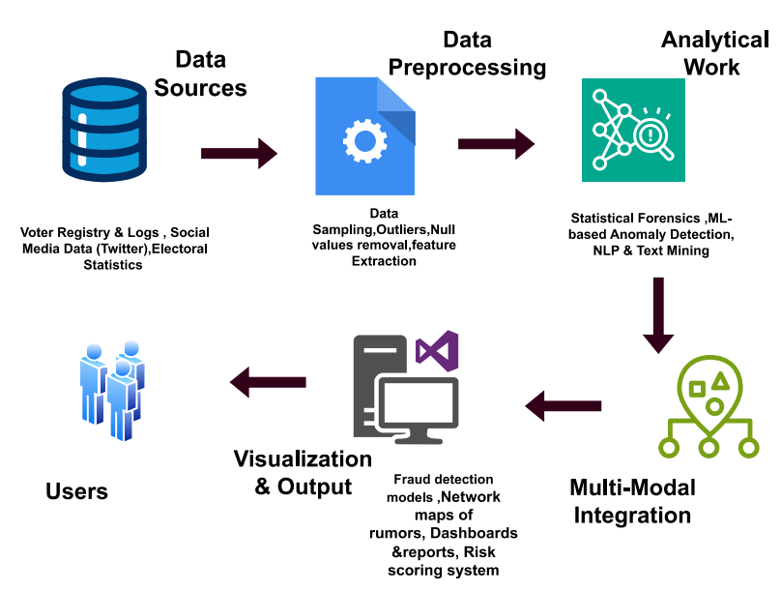
Forensics Analytics
System Architecture & Workflow

Slide 6
Forensics Analytics
Home
About
Content
Others
Dataset Used
Voter Registry: Synthetic dataset, 1,000 records, with known injected anomalies.
Tweet/Social Media: Curated election-related tweets (sample, e.g., 500–1,000), with features: text, time, user/meta, propagation patterns.

Slide 7
Forensics Analytics
Home
About
Content
Others
Preprocessing
Cleaned redundant entries, standardized text, and formatted numeric fields.
Excluded missing key IDs, imputed minor numeric gaps with medians.
Derived turnout %, vote share, and victory margin features.
Performed stratified random sampling for balanced exploratory testing.

Slide 8
Forensics Analytics
Home
About
Content
Others
Feature engineering
Registry: Age, ID, address, citizenship, risk scoring
Tweets: Sentiment (VADER/TextBlob), bot probability (Botometer-like features), hashtag frequency, rumor propagation speed, user influence score.

Slide 9
Forensics Analytics
Home
About
Content
Others
Analytical Tools
Statistical Forensics: Benford’s Law, t/chi²/normality tests (voters)
NLP: Sentiment, topic modeling, rumor detection, network graphs (tweets)
ML: Random Forest/GBM (classification of risk), Isolation Forest/DBSCAN (anomaly detection) applied to both datasets
Fusion: Composite risk—highest risk for user-record in either dataset triggers review.

Slide 10
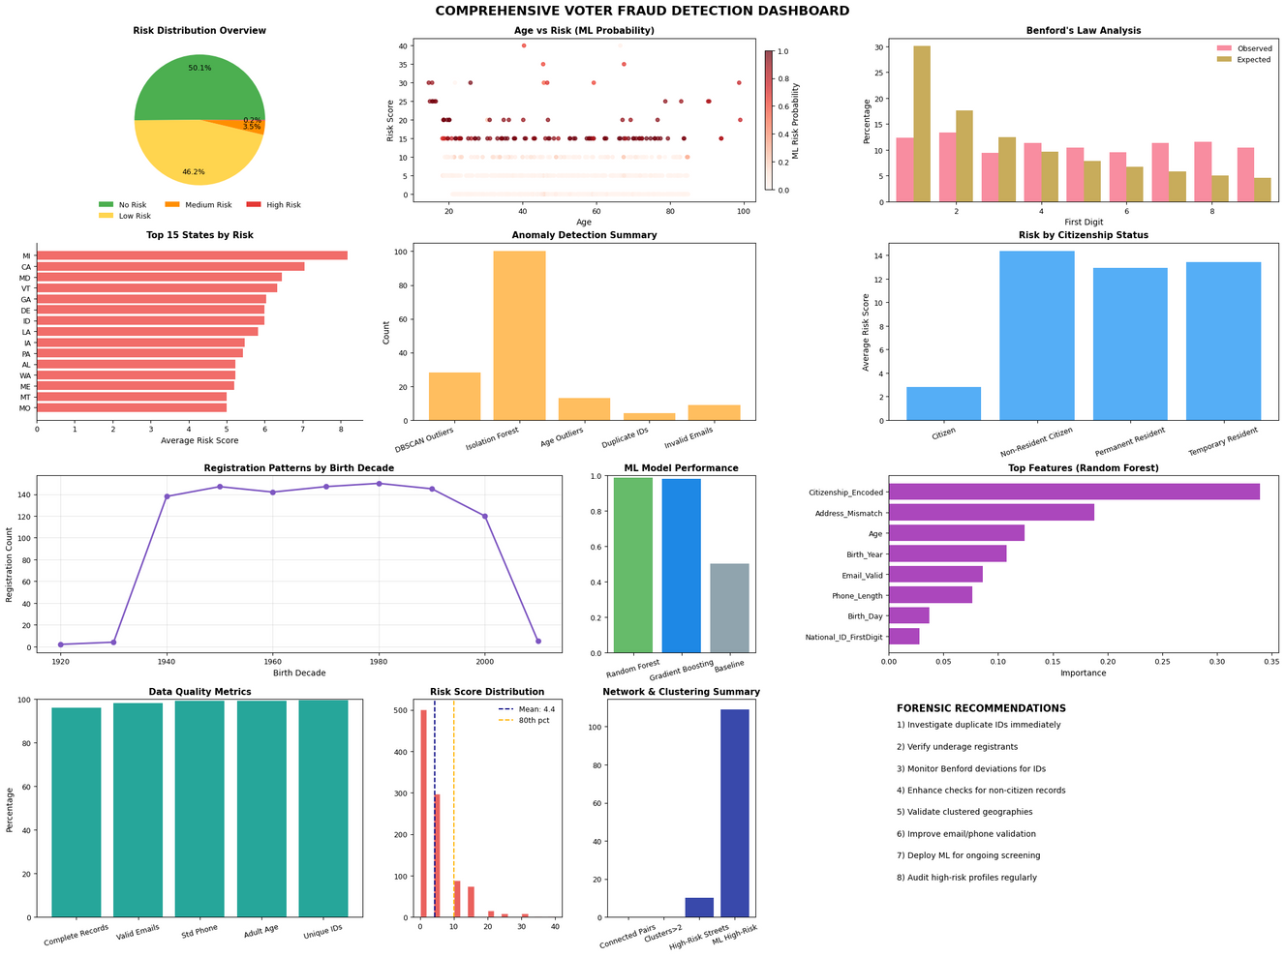
Forensics Analytics
Home
About
Content
Others
Visualizations
Integrated dashboard displaying both registry and tweets risk metrics (side-by-side or overlay), network propagation map, top-keyword cloud.

Slide 11
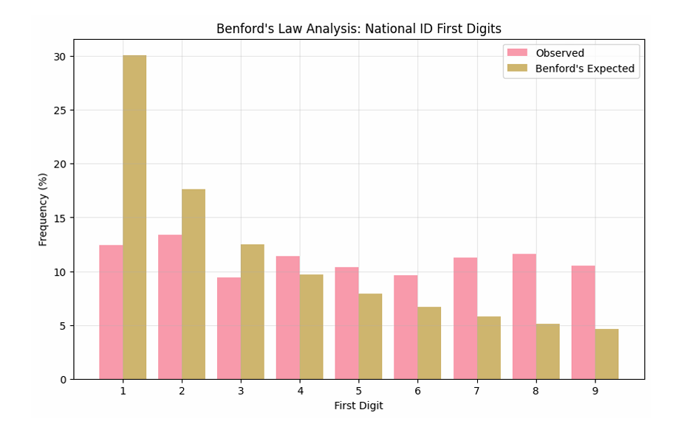

Forensics Analytics
Home
About
Content
Others

Slide 12
Forensics Analytics
Home
About
Content
Others
Most records are No or Low Risk, indicating good data quality, but a non-trivial segment needs scrutiny.
Visualizations
High-risk cases cluster among the youngest, oldest, and some middle-aged voters, confirming age as a risk factor for anomalies.

Slide 13

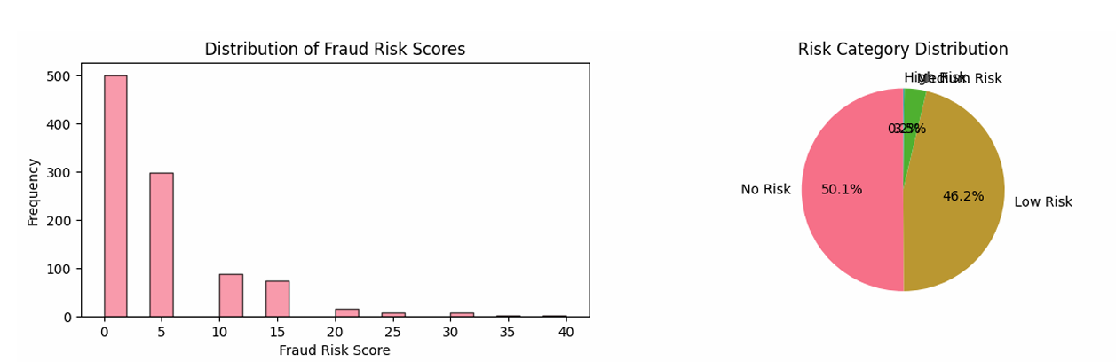
Forensics Analytics
Home
About
Content
Others
Fraud Risk Scores
Risk Category Distribution
13

Slide 14
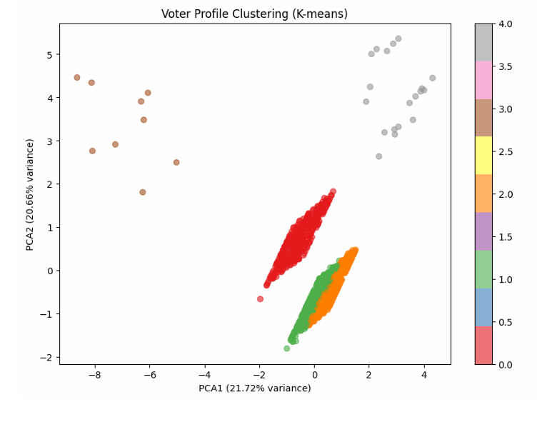
Forensics Analytics
Home
About
Content
Others
Voter Profile Clustering(K-Means)

Slide 15
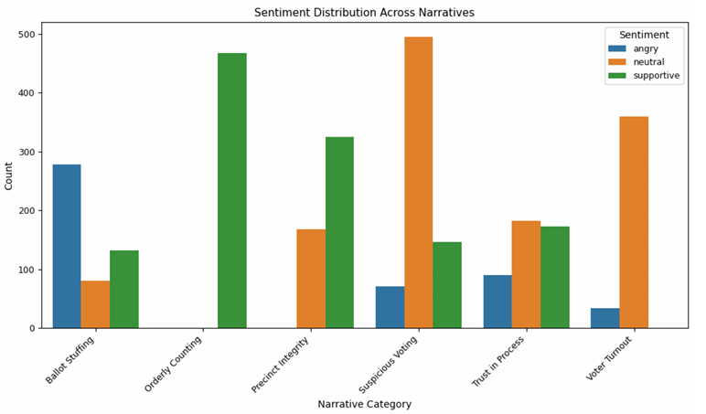
Forensics Analytics
Home
About
Content
Others
Forensic Modeling & Narrative Analysis (NLP)

Slide 16
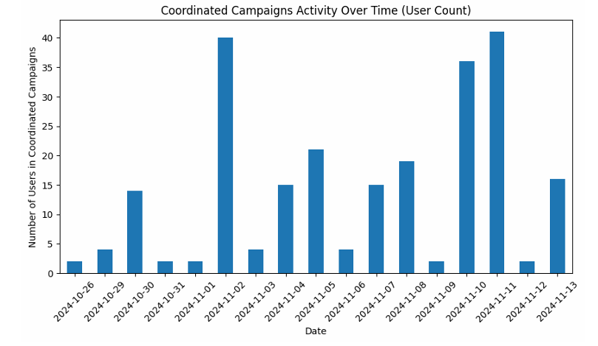
Forensics Analytics
Home
About
Content
Others
Anomaly & Coordinated Behavior Detection

Slide 17
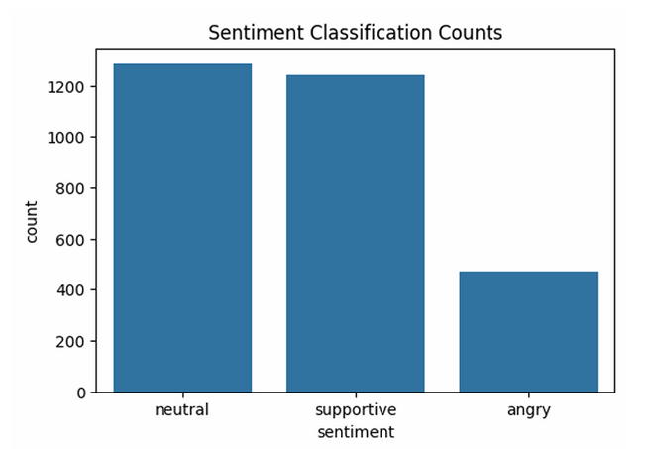
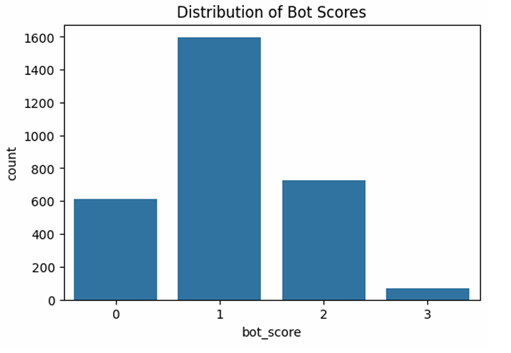
Forensics Analytics
Home
About
Content
Others
Bot Scores Histogram
Sentiment Classification Counts

Slide 18
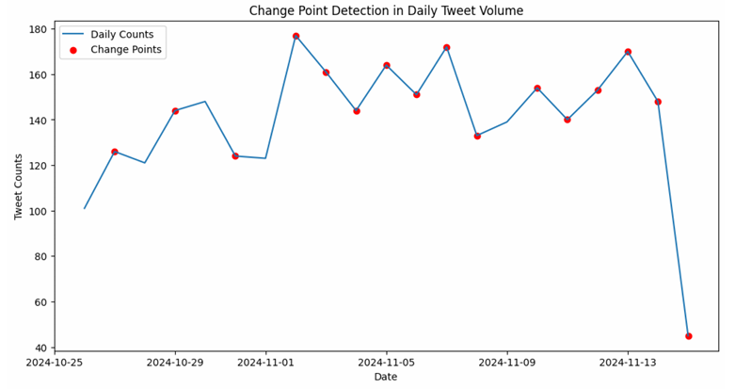
Forensics Analytics
Home
About
Content
Others
Temporal & Network Analysis
Time-Series Analysis (CUSUM):
The CUSUM algorithm was used on daily tweet counts to spot specific days when activity sharply increased or decreased, highlighting periods of coordinated campaigns or emerging events.
User Similarity Network:
A dense network graph, built using cosine similarity of user tweet text, connected 926 accounts with 10,243 links—revealing heavy overlap in language and talking points, and suggesting clusters of users amplifying similar narratives.

Slide 19
Forensics Analytics
Home
About
Content
Others
Results & Key Findings (Voter Dataset)
Duplicate IDs: 4 unique, 8 records flagged.
Outlier ages: 7 underage, 6 elderly.
Benford’s Law failure: Chi² = 355.91 vs critical 15.51 (major anomaly).
39 records flagged for multiple risk factors.

Slide 20
Forensics Analytics
Home
About
Content
Others
Results & Key Findings (Voter Dataset)
K-Means clustering: 5 voter profiles, some concentrated on address mismatch.
Random Forest: 98.6% accuracy; top predictors are citizenship, address mismatch, age.
Visual: Feature importance bar chart and clustering plot.

Slide 21
Forensics Analytics
Home
About
Content
Others
Results & Key Findings (Tweet Dataset)
LDA topic modeling: Reveals 6 major election fraud narratives; "Suspicious Voting" most prevalent.
Sentiment split: Ballot stuffing/angry, orderly/supportive.
Misinformation flagging via anomaly scores; top phrases identified.
Narrative & Misinformation Analysis

Slide 22
Forensics Analytics
Home
About
Content
Others
Results & Key Findings (Tweet Dataset)
Isolation Forest flags outlier tweets with high-risk phrasing.
58 coordinated campaign groups found; repeated content posted in tight time frames.
Coordinated users show high bot scores (statistical significance, p=0.0011).
Network graph of user similarity shows hubs and amplification.
Anomaly & Coordinated Campaigns

Slide 23
Forensics Analytics
Home
About
Content
Others
Conclusion & Recommendations
Multi-modal forensic analytics framework strengthens fraud detection and review.
Key actions: Audit flagged anomalies (IDs, ages, bots), monitor narratives, deploy real-time dashboards.
Future: Apply to real data, add hybrid event-time analysis, periodic retraining.

